Slide 1
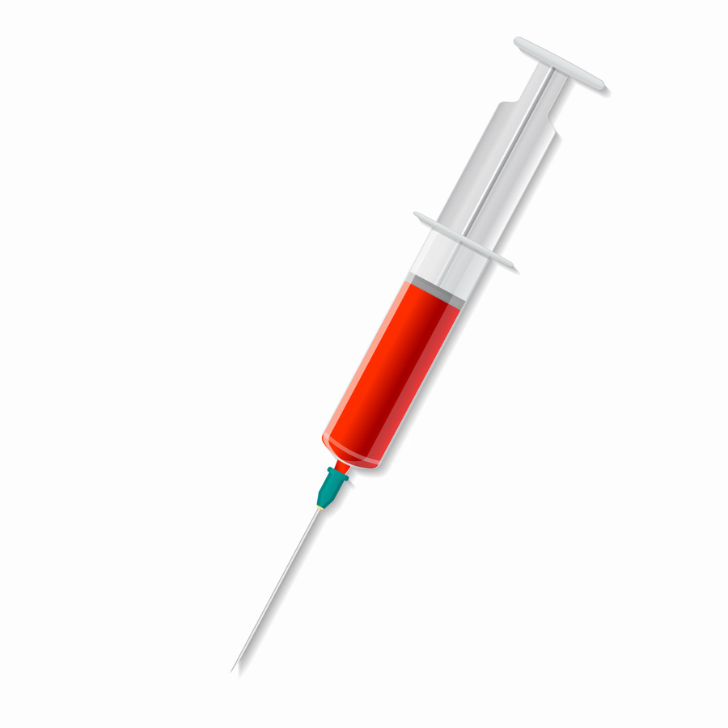
Phlebotomy Program
Fall 2024 – Eureka
Adult and Community Education
Program Director: Jim Gordon
Instructors: Jim Gordon and Talia Ciarabellini

Slide 2
Welcome and Introductions

Slide 3
Agenda
What phlebotomy is and what it is not
What are the state requirements?
Course information, dates and format
Application process
Cost and funding options

Slide 4
What’s a Phlebotomist?
Practices in hospitals, clinics and freestanding labs
Direct patient contact/care
Responsible for blood draws (venipuncture) and collections
Does not administer medications or initiate IV access

Slide 5
What makes a good Phlebotomist?
Patience!
Empathy
Critical thinking skills
Communication skills
People skills

Slide 6
About the course..
Not-for-Credit Program
Nationally recognized certification exam is included (NHA)
Class includes:
Phlebotomy class
Basic CPR
Textbooks, handouts, and NHA online resources and practice tests
Materials and supplies for laboratory portions of the class
Clinical rotation in a healthcare facility
Job Prep (resume, cover letter, interviewing)

Slide 7
Class Dates and Format
Dates: Aug 27th – Dec 5th, 2024
29 in person didactic/lab sessions – includes 2 makeup days
Days: Tuesdays & Thursdays
Time: 5:30PM – 8:30PM
Location: 525 D Street, Eureka
NHA Exam: Thursday, December 21, 5:30pm-8:00pm
***Dates are subject to change***

Slide 8
Clinical Externship Entrance Requirements
Healthcare requirements are subject to the requirements of the clinical site and CR’s policies and are subject to change.
The following will be due on the First Day of Class:
Background Check through Castle Branch Approximately $35.
Signed Disclosure Statements
Immunizations Records – No Exceptions!
ALL outstanding requirements must be met by October 31, 2023
Physical Exam (we will provide this form)
You cannot enter the clinical portion of the class unless you submitted proof of all the required immunizations and all documentation has been signed and approved.

Slide 9
Immunizations Costs and Guidelines
You must have these on the first day of class
Immunization or Titer | Approximate Cost* | Provided By
MMR – 2 doses – 4 weeks apart | $17.00 | Public Health or Pharmacy
Varicella/Chicken Pox – 2 doses – 4 weeks apart | $129 | Public Health
Hepatitis B Series - 3 Doses - 4 weeks between 1st two doses, 8 weeks between dose 2 & 3, but 16 weeks between dose 1 & 3 | $55/Per Dose | Public Health
TDAP – 1 dose | Unknown | Public Health
TB - PPD – 1 Negative test within last 12 months or 1 Quantiferon test – no more than 3 months old | Unknown | Public Health
Seasonal Flu (after August) | $10 Suggested Donation | Public Health or Pharmacy
COVID Moderna – 2 doses + booster – 4 weeks between 1st 2 doses, Booster after 5-6 months Pfizer – 2 doses + booster – 3 weeks between 1st two doses, Booster after 5-6 months Johnson & Johnson – 1 dose + booster, Booster after 2 months | Free | Public Health or Pharmacy

Slide 10
Immunization Information
Immunizations are absolutely required – no exceptions!
Can be obtained through your doctor, a pharmacy or at
Public Health Main Clinic.
If you already have these you do not have to get them again
Immunization records can be submitted upon acceptance into the program, but no later than the first day of class
If you think you’ve already had these or had the illness you can get a Quantitative Titer :
This will show that you have the antibodies. If no antibodies are shown; you must get the immunization.

Slide 11
Clinical Externship
Performed at a local healthcare facility
Program Director must place you and will make every attempt to place you in your preferred clinical location.
Once placed you will be contacted to pickup your blue clinical folder from our office. This will be used to record the following: 40 hours and 50 successful venipunctures. (10 Dermals & 2 Arterial Blood gas observations – TBD where).
It will be the responsibility of the student to keep track of this folder and submit it to the ACE office upon completion

Slide 12
Requirements to apply for CPT 1 License
HS grad or equivalent - transcripts must be sent to CDPH
Background check
Complete an approved certification program (like this one)
Pass the National Healthcare Association Phlebotomy certification exam
Complete a 40 hour Clinical Externship
Submit application to the California Department of Public Health with required fees

Slide 13
Health and Safety
Class size limited to18 students
PPE and hand/hygiene available
If you’re sick, stay home
Call and email your instructor, as well as the ACE office.
Absences are limited, monitored and enforced

Slide 14
Costs
Class Fee: $1,995.00
Other anticipated costs:
Background Check - $35-$37
Immunizations – costs will vary
CPT 1 License Fees - Approximately $100

Slide 15
Payment options
There are three (3) ways to pay for the class:
Student pays personally with Cash, Check or Credit/Debit Card
Nelnet Payment Plan
Student is sponsored by an agency
Numerous potential opportunities: local, county, state or federal
Potential sponsorship opportunities form on website
Until we have documentation in our office proving sponsorship, we cannot move forward!

Slide 16
Nelnet Payment Plan
Class | Phlebotomy Payment Plan
Total Cost | $1,995
Down Payment | Option 1: $1,000 & $20 Payment Plan Fee Due upon registration Option 2: $500 & $20 Payment Plan Fee Due upon registration
Monthly Payment Amount | Option 1: Approximately $332 for 3 months Option 2: Approximately $500 for 3 months
Payment plans are to be processed with a Debit/Credit card only!
Payment plans are available through Nelnet.
There is a $20 payment plan fee.
Payment plans must be set up when you register for class.
If you choose to set up a payment plan your Certificate of Completion will be issued upon completion of your payment plan.
All payments must be complete prior to being allowed to take the NCCT exam.

Slide 17
Application Period – Opens June 14th, 2024
Application will be available on the program webpage
Application period closes July 11, 2024 at 12:00pm
Random lottery drawing: July 11, 2024
All names will be drawn and assigned a #
First 18 will receive acceptance letters
Remaining will be assigned a waitlist #.
Accepted letters will include:
Registration form, release on information form, background check information and immunization checklist
Waitlist letters will include:
Background check information and immunization checklist
Payment is due at time of registration or must include a sponsorship letter

Slide 18
Questions????
Email: ACE@redwoods.edu
Phone: 707-476-4500
Address: 525 D Street Eureka, CA 95501
Office Hours: Monday – Thursday 8:30a-4:30p

